Slide 1


Slide 2

The Problem
Test Preparation is HARD! Why?
Most people preparing for the GMAT do it alongside full time work / full time uni
Traditional preparation methods require a massive time commitment - at least multiple hours everyday
People don’t feel motivated to study after a long day at work / school
They constantly procrastinate and are inefficient - wasting years of their life - time they could have spent on actual growth

Slide 3

The Solution
Testopia, test prep you want to do.
An app that gamifies competitive exam preparation, with different levels, reward points, and leaderboards.
An app that customises your study plan, coursework and difficulty with AI.
An app that you can use for 5-10 minutes a day, ensuring sustainability and democratising access.
An app which makes test prep accessible, easy, and fun.

Slide 4
The Challenge
How do we build a question bank with gamified versions of the GMAT questions?
How do we build this question bank at scale?
How do we optimise difficulty levels to suit different people?
How do we assess if concepts tested with the new questions are similar to the concepts tested on the GMAT?
Answer: AI tools

Slide 5
Our Process
Data set:
50 GMAT quantitative questions, 50 “Level 1” basic gamified questions, 50 “Level 2” hard gamified questions
Classification of skills tested in the different questions generated
Evaluation:
Same skills tested in gamified versions of questions
Relevance and appropriate difficulty of gamified questions
Challenges Encountered
Actions to Mitigate
Initial output gave questions that were too simple
Output was unformatted
Tailored prompt to provide 2x levels of gamified questions (easy, hard)
Specified the required format in prompt

Slide 6
Demo!
https://colab.research.google.com/drive/1OgXA5R70UWpOfxjv8GcFYuMNIHySRIin?usp=sharing

Slide 7
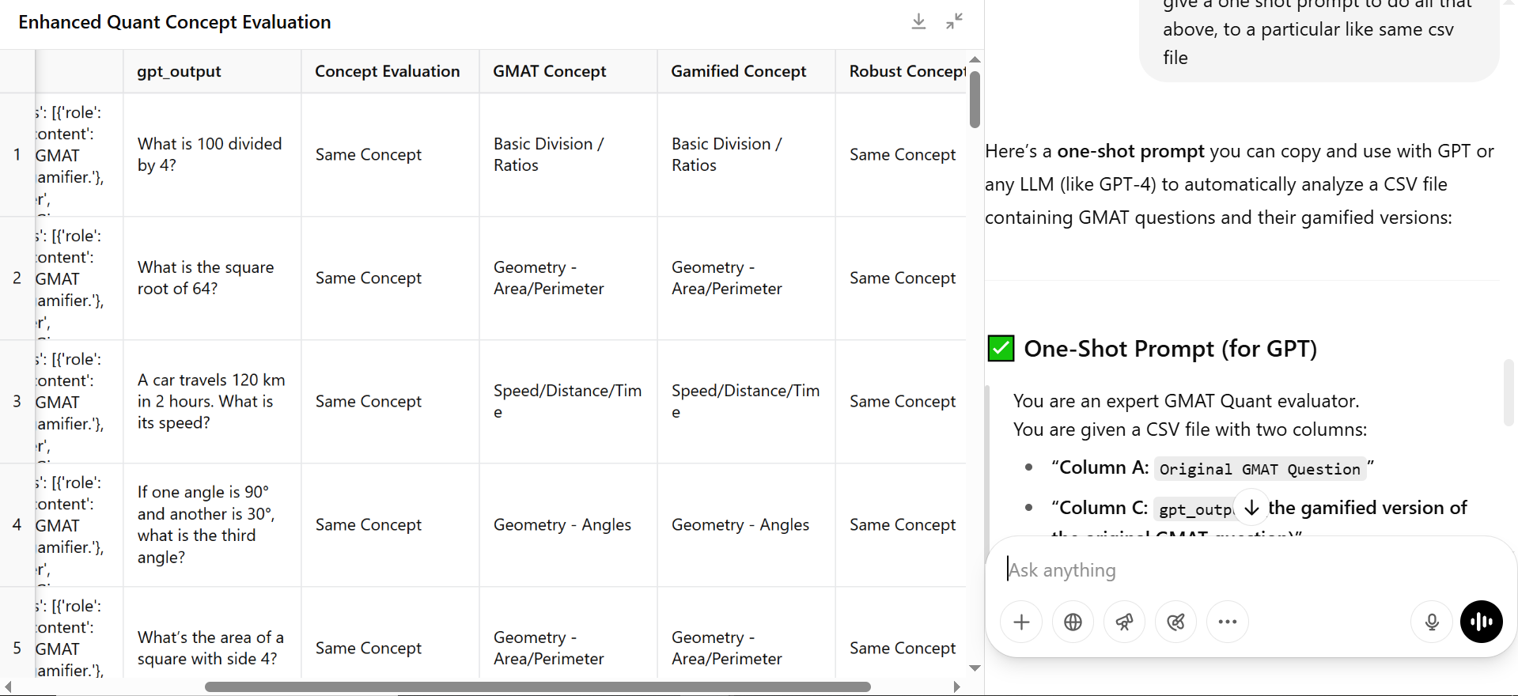
Evaluation
Evaluation prompt :
You are an expert GMAT Quant evaluator.
You are given a CSV file with two columns:
Column A: Original GMAT Question
Column C: gpt_output (the gamified version of the original GMAT question)
Your tasks are:
For each row, identify the quant concept being tested in both the original and gamified question. Examples: Speed/Distance/Time, Percentages, Geometry - Area, Angles, Basic Division, Square Root, Algebra, Averages, etc.
Check if both questions are testing the same underlying quant concept.
Add three new columns to the data:
GMAT Concept
Gamified Concept
Robust Concept Evaluation: say "Same Concept" or "Different Concept"

